Slide 1
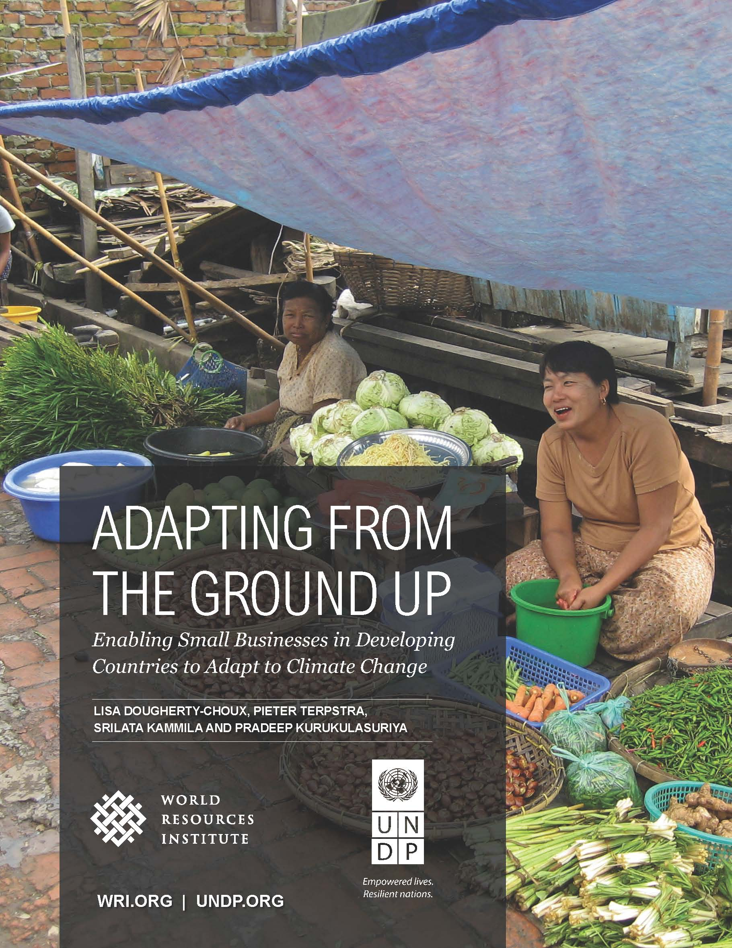
ADAPTING FROM THE GROUND UP: Report findings
Source: WRI/UNDP

Slide 2
What’s in the Report?
Drivers of Investment in Adaptation
Barriers to Investment in Adaptation
Interventions to Catalyze Private Sector Engagement
Principles for Engaging MSEs in Adaptation
Recommendations
Annexes: Case Study Details

Slide 3
A MENU OF INTERVENTIONS TO CATALYZE MSE engagement
Business relevant climate information and risk analysis
Technical assistance and training
Government policies
Market and business development
Partnerships and cooperatives
Financial instruments
Source: WRI/UNDP, Image:UNDP Tajikistan

Slide 4
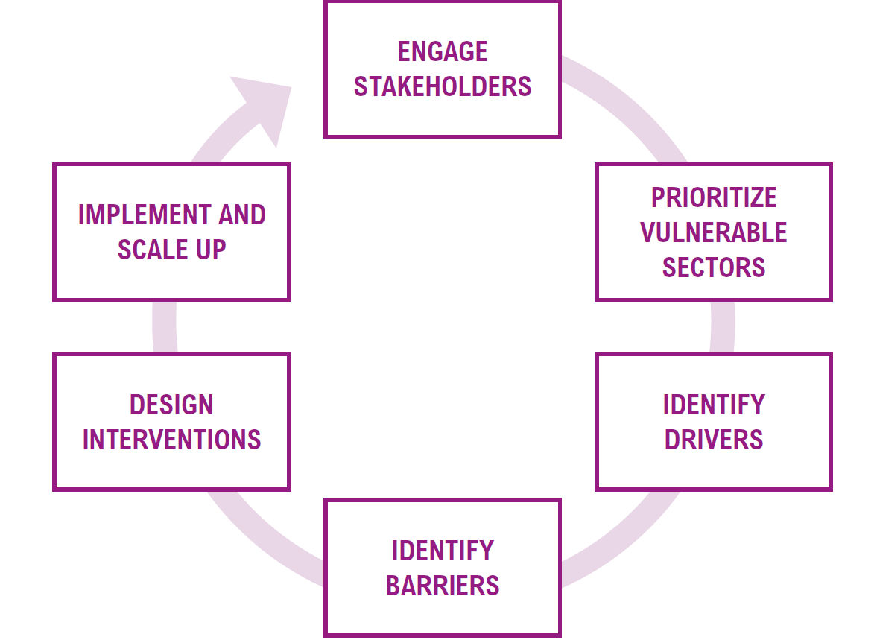
Principles for Engaging MSES
Source: WRI/UNDP

Slide 5
Overarching recommendations
National governments should engage MSEs in national adaptation planning
International donors can set the agenda, provide technical support, and help with market access
Special climate funds can direct their expertise to MSE-related programs
Large private companies can invest through finance and technical support

Slide 6
Detailed case studies from the Agriculture Sector in:
Zimbabwe
Cambodia
Tajikistan
Nicaragua

Slide 7
Thank you! Heather McGray hmcgray@wri.org

